Slide 1
Statewide Analysis of Bicycle Crashes in North Carolina
Prepared By:
Matt Dardari
Preethika Gajendran
Rashi Waghray

Slide 2

Project Objectives
Study overall statewide bicycle crash patterns and trends in North Carolina.
Perform descriptive trend analysis of crashes based on the following factors:
Environmental factors
Bicyclist-related factors
Crash location
Motorist / Motor Vehicle-related factors
Roadway Characteristics
Identify bicycle crash hot spots/cities within the state
Identify danger zones based on crashes that resulted in fatalities

Slide 3



Dataset Used for Analysis
https://www.chapelhillopendata.org/
Maps the locations of crashes involving bicyclists in North Carolina from Jan 2007-Dec 2018
Police-reported bicycle collisions with motor vehicles
Crashes occurred on:
the public roadway network
public vehicular areas
private properties (if reported)
Exclusions:
Crash identification numbers
Fatality count

Slide 4
Data Cleaning Process
Grouped similar values:
Crash Group
Road Conditions
Binning items into categories:
Time of Day
Renaming Column Headers
Dropping unknown/missing/unwanted values during analysis

Slide 5
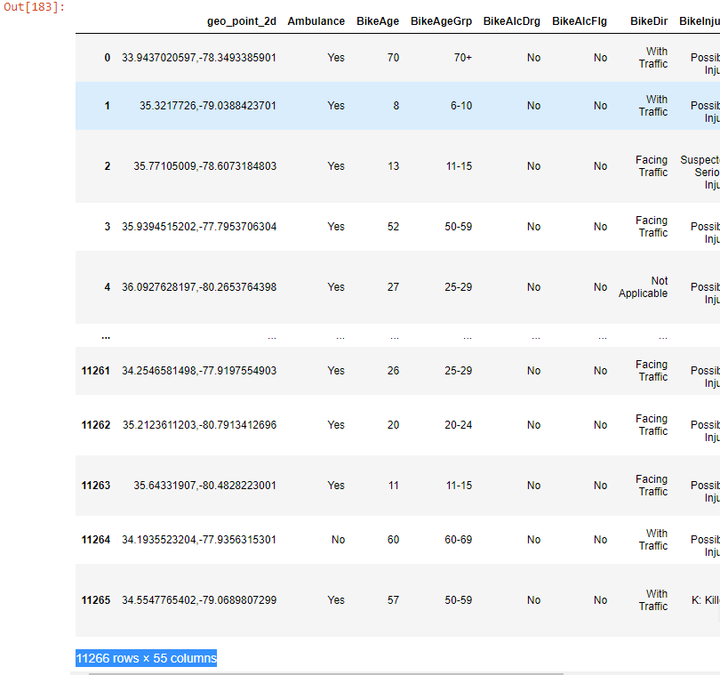
Basic Data Analysis
Total reported crashes = 11266
All 100 counties within the State
327 cities
Crash sites not within the bounds of these 327 cities are categorized as “Rural” sites

Slide 6
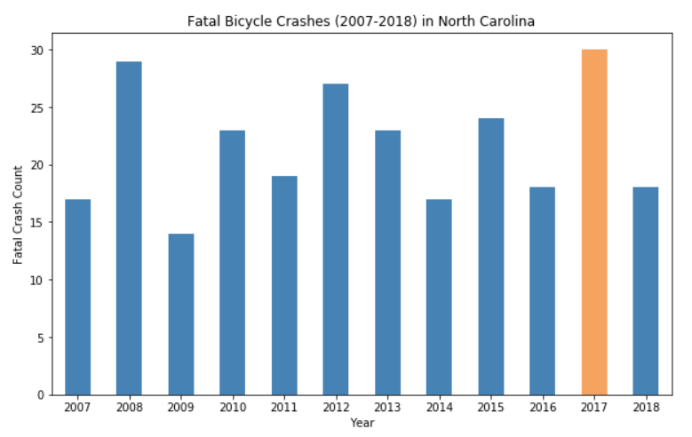
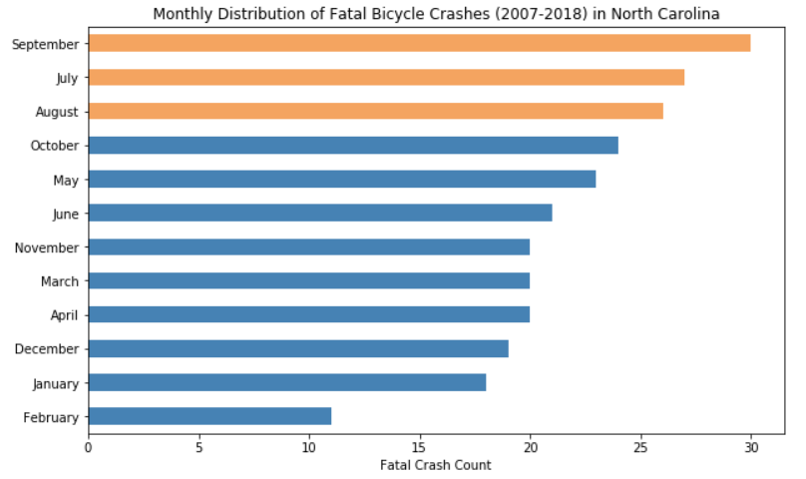
Bicycle Crash Fatality Analysis – WHEN?
Total crashes = 11266
Total Fatal Crashes = 259
Crashes resulting in the death of a biker = 250
Crashes resulting in the death of a motorist = 2
Crashes resulting in the death of a pedestrian = 7
Yearly Average = 22 fatal crashes/year
Most fatal crashes 30(12%) occurred in 2017
About a third of the fatal crashes 81(32%) occur in the summer months Jul – Sep

Slide 7
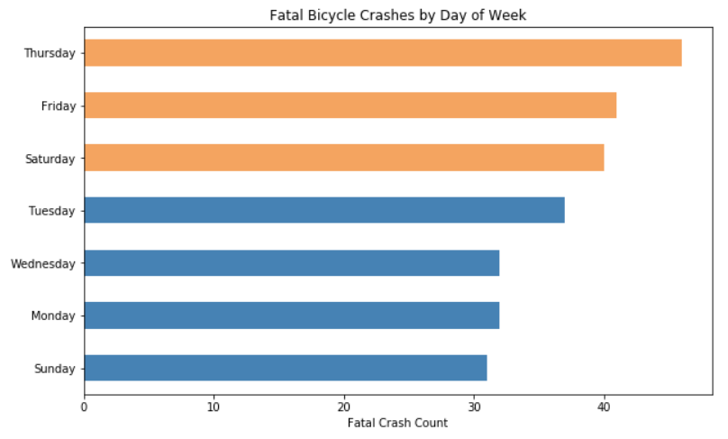
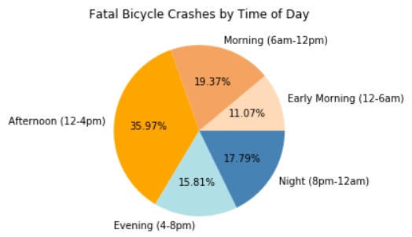
Bicycle Crash Fatality Analysis – WHEN?
DAYS OF THE WEEK:
About half 127(49%) of the fatal crashes occur between Thursday-Friday-Saturday
TIME OF DAY:
More than a third of the fatal crashes 91(36%) occur in the afternoon (12-4pm)

Slide 8
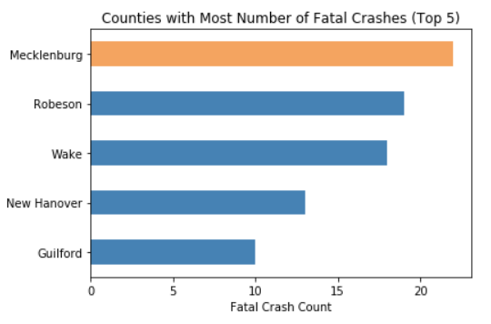
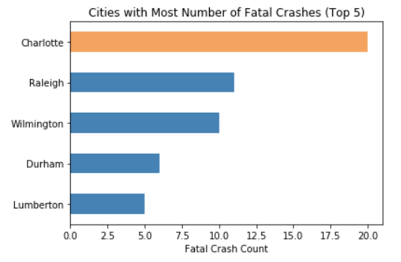
Bicycle Crash Fatality Analysis – WHERE?
COUNTY:
Mecklenburg county had the most fatal crashes 22(8.5%) in the state
CITY:
Charlotte is the city with the most fatal crashes 20(8%) in the state

Slide 9
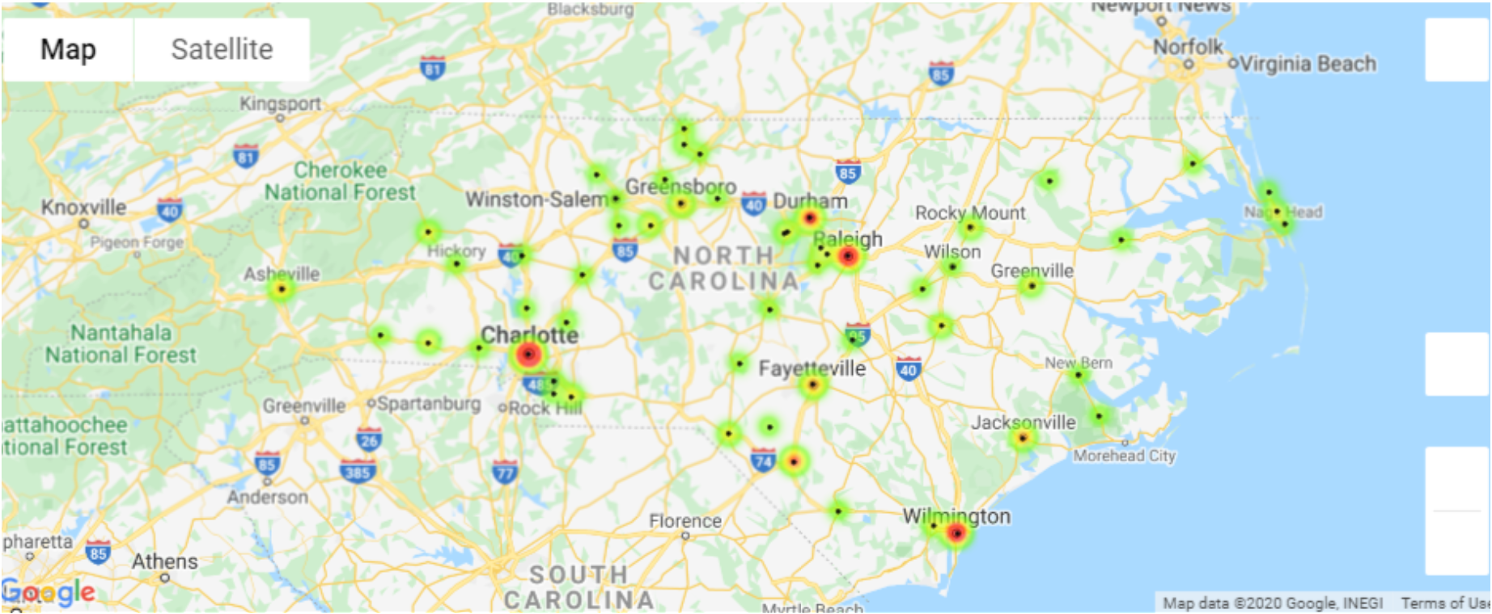
Bicycle Crash Fatality Analysis – Most Fatal Cities

Slide 10
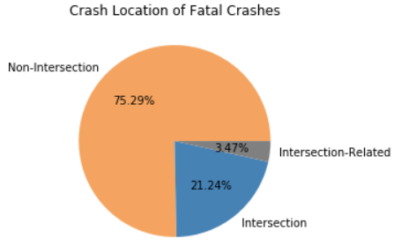
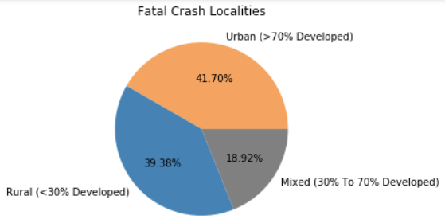
Bicycle Crash Fatality Analysis – WHERE?
LOCALITY:
Most fatal crashes 108(42%) occur in Urban Localities (>70% Developed) within the state
CRASH LOCATION:
Majority of fatal crashes 195(75%) took place at Non-Intersections

Slide 11
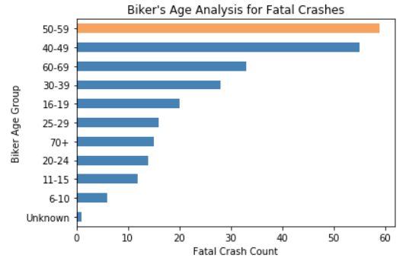
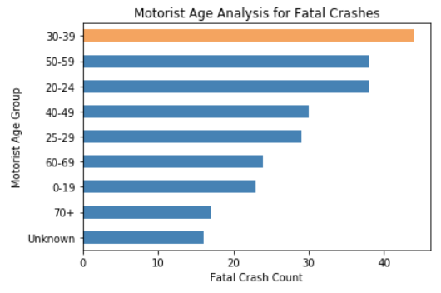
Bicycle Crash Fatality Analysis – WHO?
BIKER AGE:
Young Bikers (<20 years) – 38(15%)
Adult Bikers (20–60 years) – 172(66%)
Elderly Bikers (>60 years) – 48(19%)
MOTORIST AGE:
Young Bikers (<20 years) – 23(9%)
Adult Bikers (20–60 years) – 179(69%)
Elderly Bikers (>60 years) – 41(16%)

Slide 12
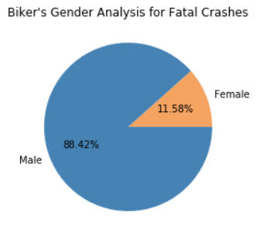
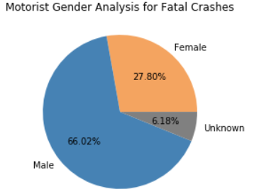
Bicycle Crash Fatality Analysis – WHO?
BIKER GENDER:
Majority of fatal crashes 229(88%) involved a male biker
MOTORIST GENDER:
Majority of fatal crashes 171(66%) involved a male motorist

Slide 13
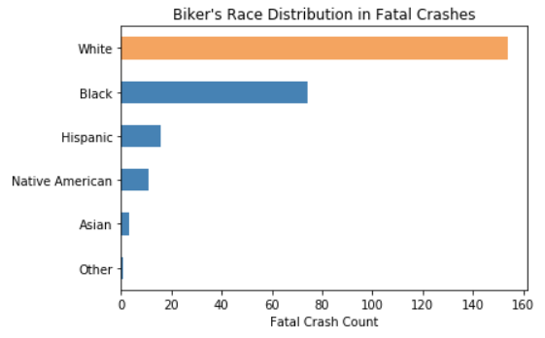
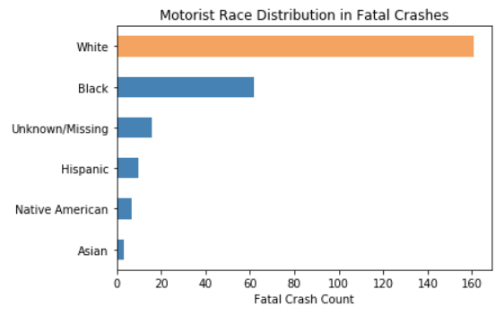
Bicycle Crash Fatality Analysis – WHO?
BIKER RACE:
Majority of the bikers 154(59%) involved in fatal crashes were Caucasians
MOTORIST RACE:
Majority of the motorists 161(62%) involved in fatal crashes were Caucasians

Slide 14
Bicycle Crash Fatality Analysis – WHY?

Slide 15
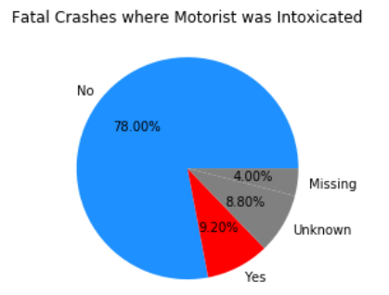
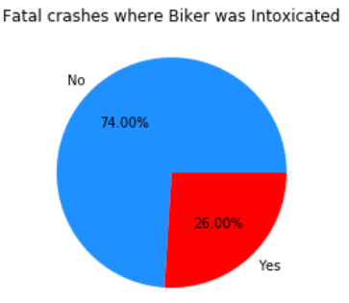
Bicycle Crash Fatality Analysis – WHY?
BIKER INTOXICATION:
A quarter of the fatal crashes had intoxicated bikers
MOTORIST INTOXICATION:
About a tenth of the fatal crashes had intoxicated motorist’s

Slide 16
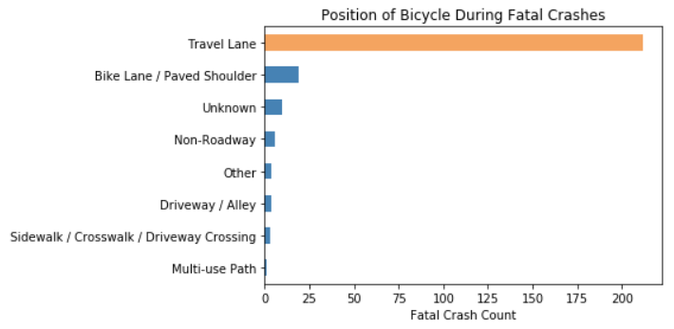
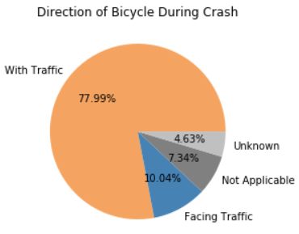
Bicycle Crash Fatality Analysis – WHY?
BICYCLE POSITION:
Majority of fatal crashes 212(82%) occurred when the biker was riding the bicycle in the travel lanes
BICYCLE DIRECTION:
Majority of fatal crashes 202(78%) occurred when the biker was riding the bicycle in the direction of the traffic

Slide 17
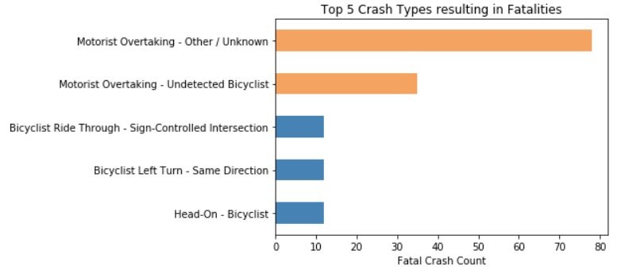
Bicycle Crash Fatality Analysis – WHY?
TRAFFIC CONDITION AT TIME OF CRASH:
About a tenth of the fatal crashes had intoxicated motorist’s
ACTION AT TIME OF CRASH:
About 113(44%) of the fatal crashes were due to a motorist overtaking the bicyclist

Slide 18
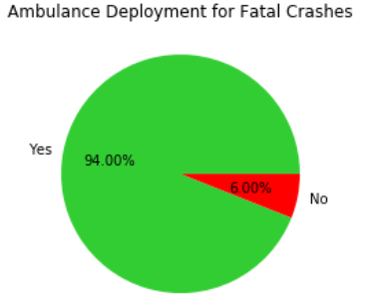
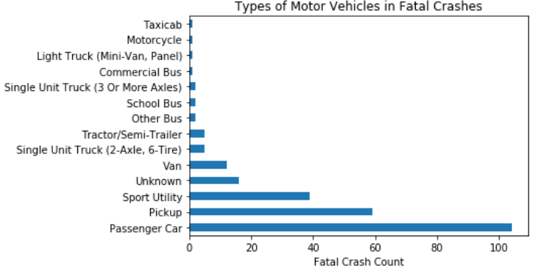
Bicycle Crash Fatality Analysis – WHY?
An ambulance was deployed for 94% of the crashes that resulted in fatalities

Slide 19
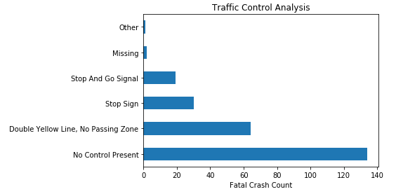
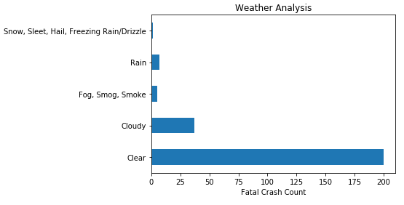
Bicycle Crash Fatality Analysis – WHY?
WEATHER CONDITIONS:
A quarter of the fatal crashes had intoxicated bikers

Slide 20
Conclusion
You are more likely to get into a FATAL crash if:
- you are a male Caucasian between 50-60 years of age riding a bicycle in a travel lane with traffic,

Slide 21
Next Steps
Injury Analysis
Analysis of use of helmets
Find correlation between county/city population and bicycle crashes

